Slide 1
Neural Network
Ilanchezhian.J

Slide 2
Architecture
Neural Network takes several inputs, processes it through multiple neurons from multiple hidden layers, and returns the result using an output layer. This result estimation process is technically known as “Forward Propagation“.
Next, we compare the result with actual output. The task is to make the output to the neural network as close to the actual (desired) output. Each of these neurons is contributing some error to the final output. How do you reduce the error?
We try to minimize the value/ weight of neurons that are contributing more to the error and this happens while traveling back to the neurons of the neural network and finding where the error lies. This process is known as “Backward Propagation“.
In order to reduce this number of iterations to minimize the error, the neural networks use a common algorithm known as “Gradient Descent”, which helps to optimize the task quickly and efficiently.

Slide 3
Elements of a Neural Network :-
Input Layer :- This layer accepts input features. It provides information from the outside world to the network, no computation is performed at this layer, nodes here just pass on the information(features) to the hidden layer.
Hidden Layer :- Nodes of this layer are not exposed to the outer world, they are the part of the abstraction provided by any neural network. Hidden layer performs all sort of computation on the features entered through the input layer and transfer the result to the output layer.
Output Layer :- This layer bring up the information learned by the network to the outer world.

Slide 4
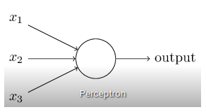
Perceptron (Artificial Neuron)
A perceptron can be understood as anything that takes multiple inputs and produces one output. For example, look at the image below.
Three ways of creating input-output relationships:

Slide 5
1. By directly combining the input and computing the output based on a threshold value. for eg: Take x1=0, x2=1, x3=1 and setting a threshold =0. So, if x1+x2+x3>0, the output is 1 otherwise 0. You can see that in this case, the perceptron calculates the output as 1.

Slide 6
Adding Weights
Next, let us add weights to the inputs. Weights give importance to an input. For example, you assign w1=2, w2=3, and w3=4 to x1, x2, and x3 respectively. To compute the output, we will multiply input with respective weights and compare with threshold value as w1*x1 + w2*x2 + w3*x3 > threshold.

Slide 7
Adding Bias
Each perceptron also has a bias which can be thought of as how much flexible the perceptron is. It is somehow similar to the constant b of a linear function y = ax + b. It allows us to move the lineup and down to fit the prediction with the data better. Without b the line will always go through the origin (0, 0) and you may get a poorer fit. For example, a perceptron may have two inputs, in that case, it requires three weights. One for each input and one for the bias. Now linear representation of input will look like,
w1*x1 + w2*x2 + w3*x3 + 1*b.
This weight and bias updating process is known as “Back Propagation“.
https://www.desmos.com/calculator/ucqwnupyzt

Slide 8
Back Propogation Cont..
Back-propagation (BP) algorithms work by determining the loss (or error) at the output and then propagating it back into the network. The weights are updated to minimize the error resulting from each neuron. Subsequently, the first step in minimizing the error is to determine the gradient (Derivatives) of each node w.r.t. the final output.

Slide 9
Activation Function
Definition of activation function:-
Activation function decides, whether a neuron should be activated or not by calculating weighted sum and further adding bias with it. The purpose of the activation function is to introduce non-linearity into the output of a neuron.
Explanation :-
We know, neural network has neurons that work in correspondence of weight, bias and their respective activation function. In a neural network, we would update the weights and biases of the neurons on the basis of the error at the output. This process is known as back-propagation. Activation functions make the back-propagation possible since the gradients are supplied along with the error to update the weights and biases.

Slide 10
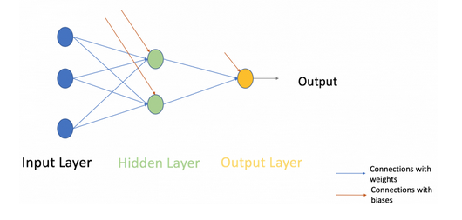
Multi-layer perceptron
An MLP consists of multiple layers called Hidden Layers stacked in between the Input Layer and the Output Layer as shown below.
every node in a layer(except the input and the output layer) is connected to every
node in the previous layer and the following layer.

Slide 11
Gradient Descent: We will run through all the sanples in the training, to do a single update for a parameter in a particular iteration. (Slower , but error rate is lower)
Stochastic GD: If we use only one training sample, to update a parameter in a particular iteration..
Minibatch: If we use a subset of samples.

Slide 12
Activation Function
If activation functions is not used, we will have only linear activation. Even multiple hidden layers will pass linear activations only
Step
Sigmoid
Relu
Leaku Relu
Softmax
Tanh

Slide 13
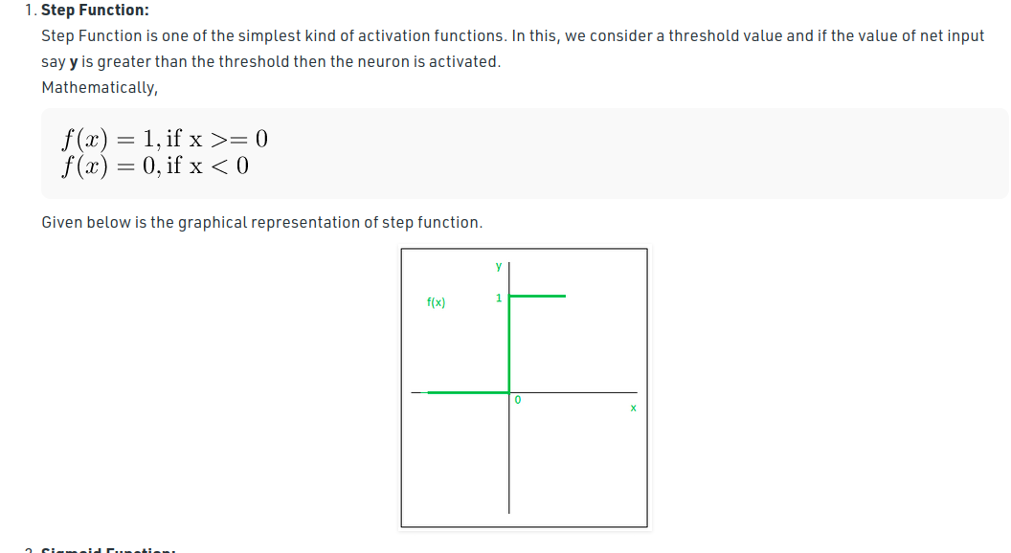

Slide 14
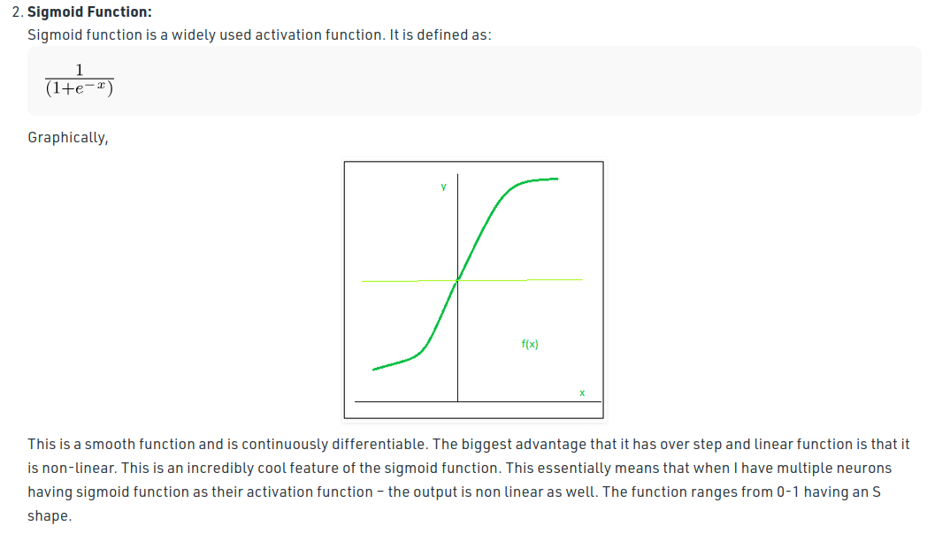

Slide 15
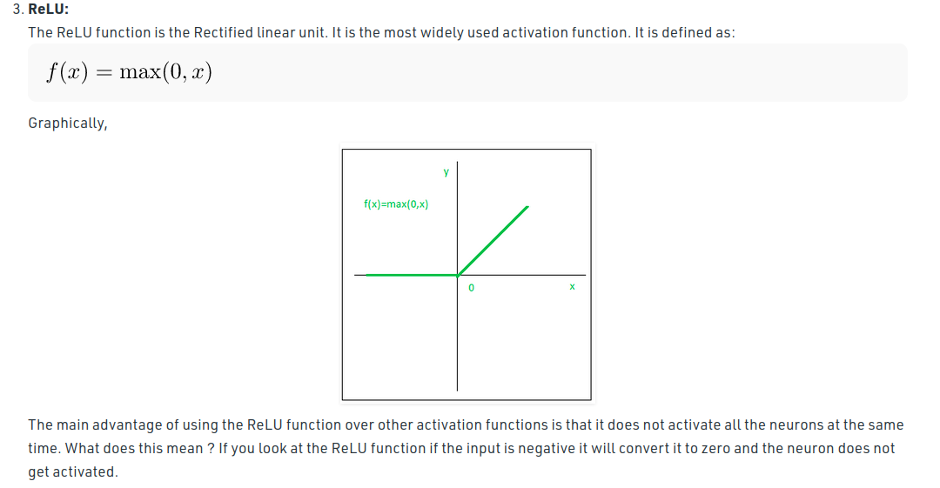

Slide 16
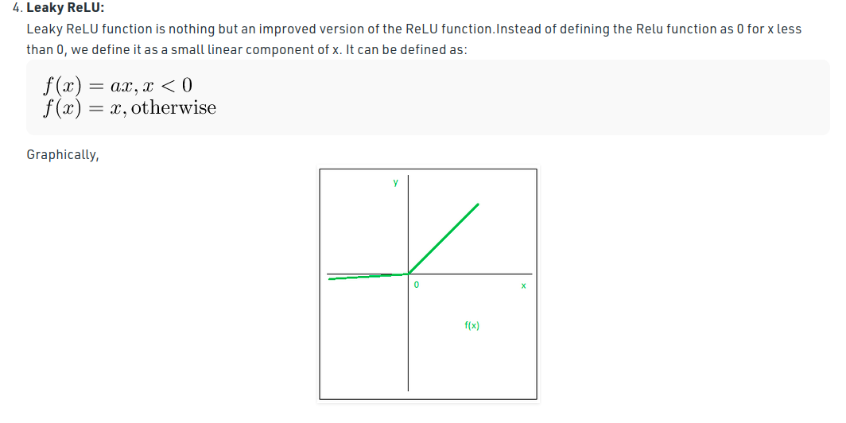

Slide 17
Which activation function to choose
Relu

Slide 18
Word Embedding- word vectorization
is reperesentation of words as vectors, such that words closer in vector are similar.
Visualization: http://vectors.nlpl.eu/explore/embeddings/en/#
Vectors: Have both magnitude and direction. (length and angle)
Types
Count Based:
Count Vector (BOW)
TF-IDF
Prediction Based :
CBOW- (Will predict the word, given a context)
Skip-Gram (will predict the context, given a word)
Word2VEc (Uses combination of both the above) - Google -1.5gb
GloVe - Global Vectors - Stanford Unversity - 800mb
fasttext - Facebook

Slide 19
Transfer Learning
Pre-Trained
Training with new data
Pre-Trained

Slide 20
NLP
Document Classification
Entity Extraction - NER (Named Entity Recognition)
Tools:
NLTK - Natural Language Toolkit
Spacy

Slide 21
RNN

Slide 22
CNN

Slide 23
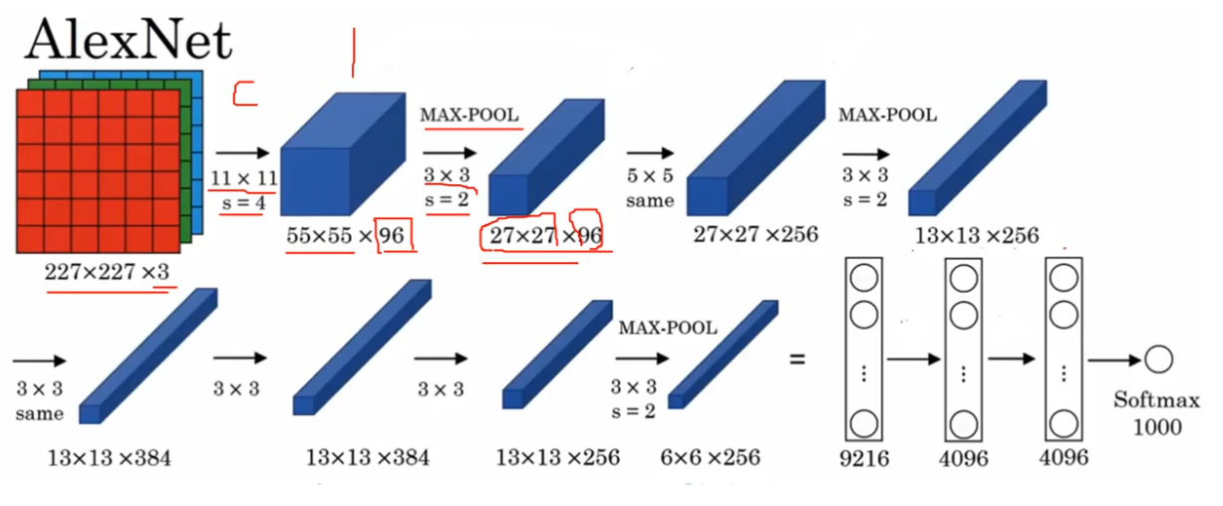

Slide 24
References
https://www.analyticsvidhya.com/blog/2020/07/neural-networks-from-scratch-in-python-and-r/
sigmoid calculator - https://machinelearningmastery.com/choose-an-activation-function-for-deep-learning/
https://www.youtube.com/watch?v=8czpAtZZ8qo

